Slide 1
Saliency based coding for Omnidirectional Videos
WEEK 5 : Bhishma Dedhia

Slide 2

Extended cut approach
Input image:

Slide 3
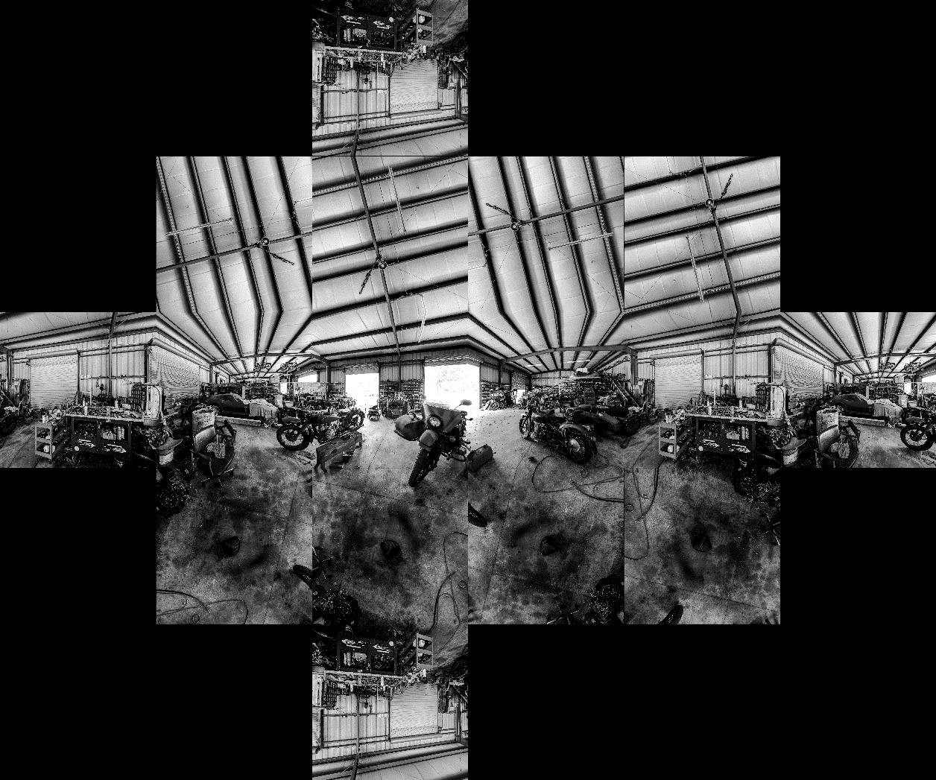
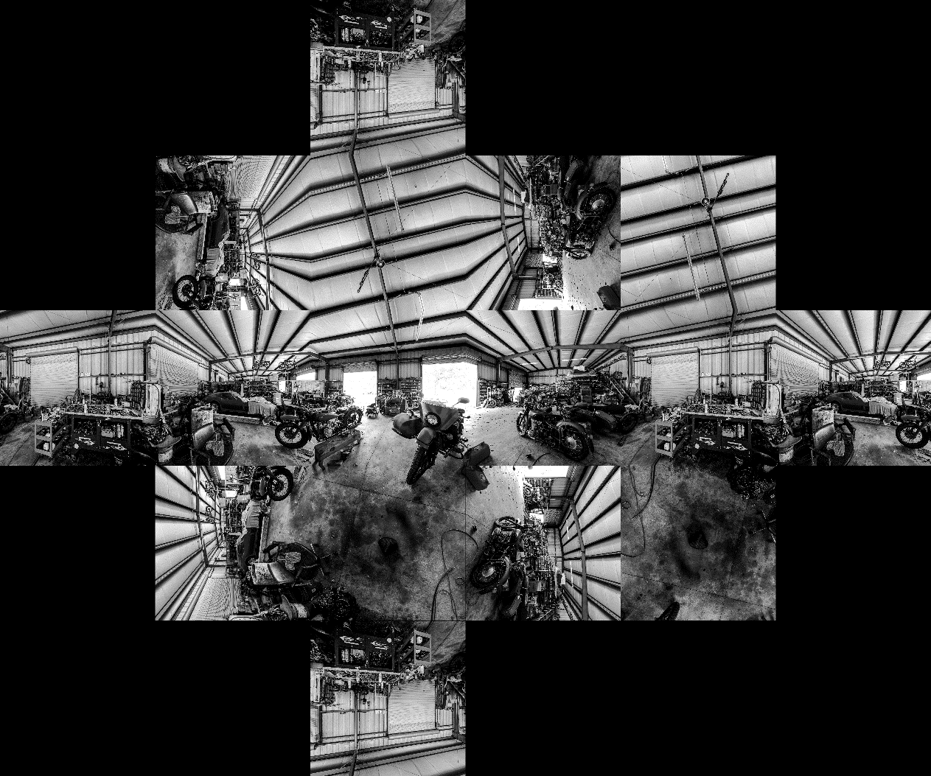
Extended Cutout: (0,0,0)

Slide 4
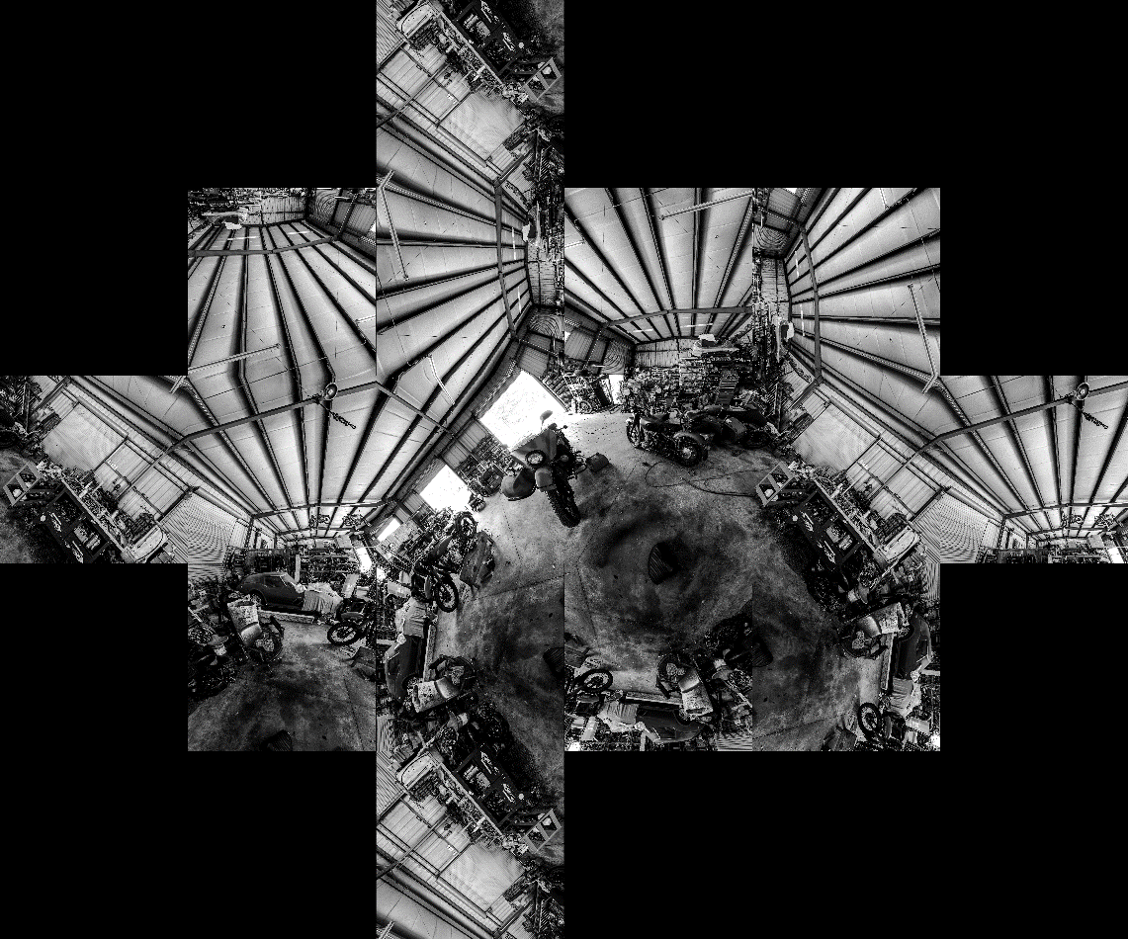
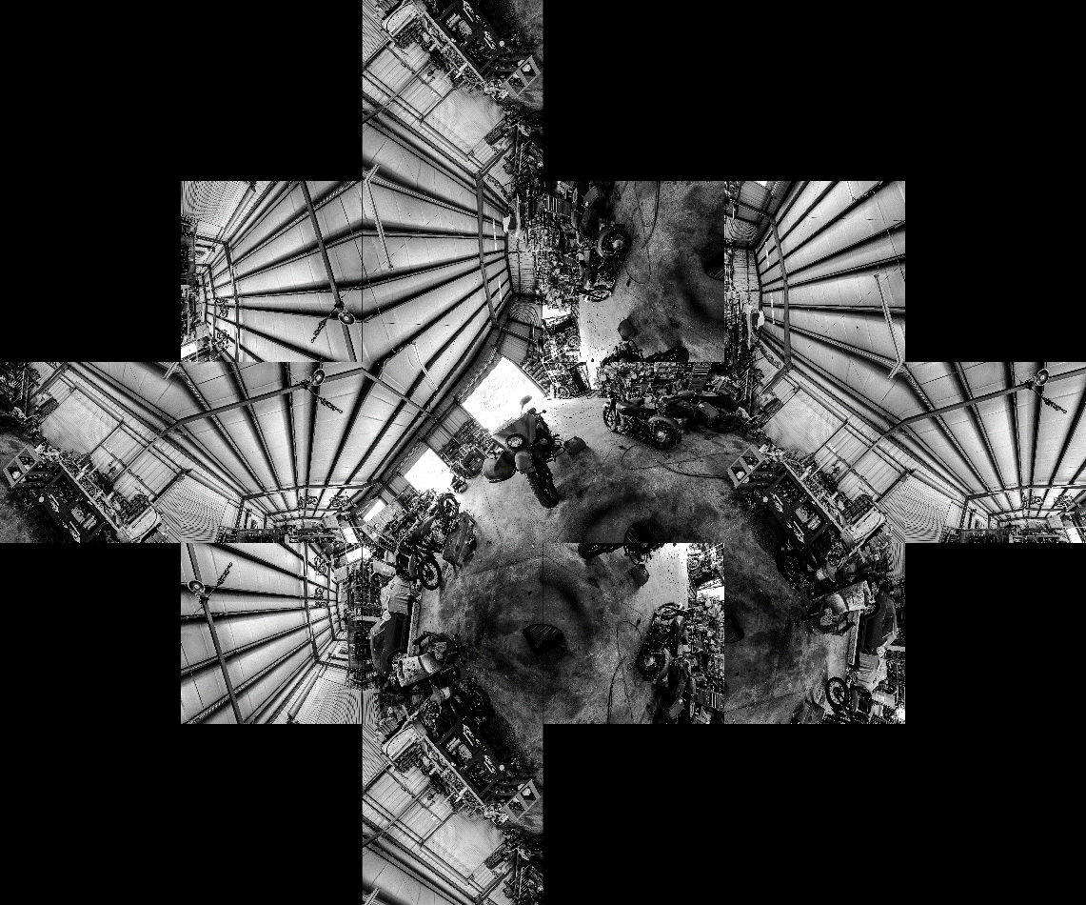
Extended Cutout: (0,0,45)

Slide 5
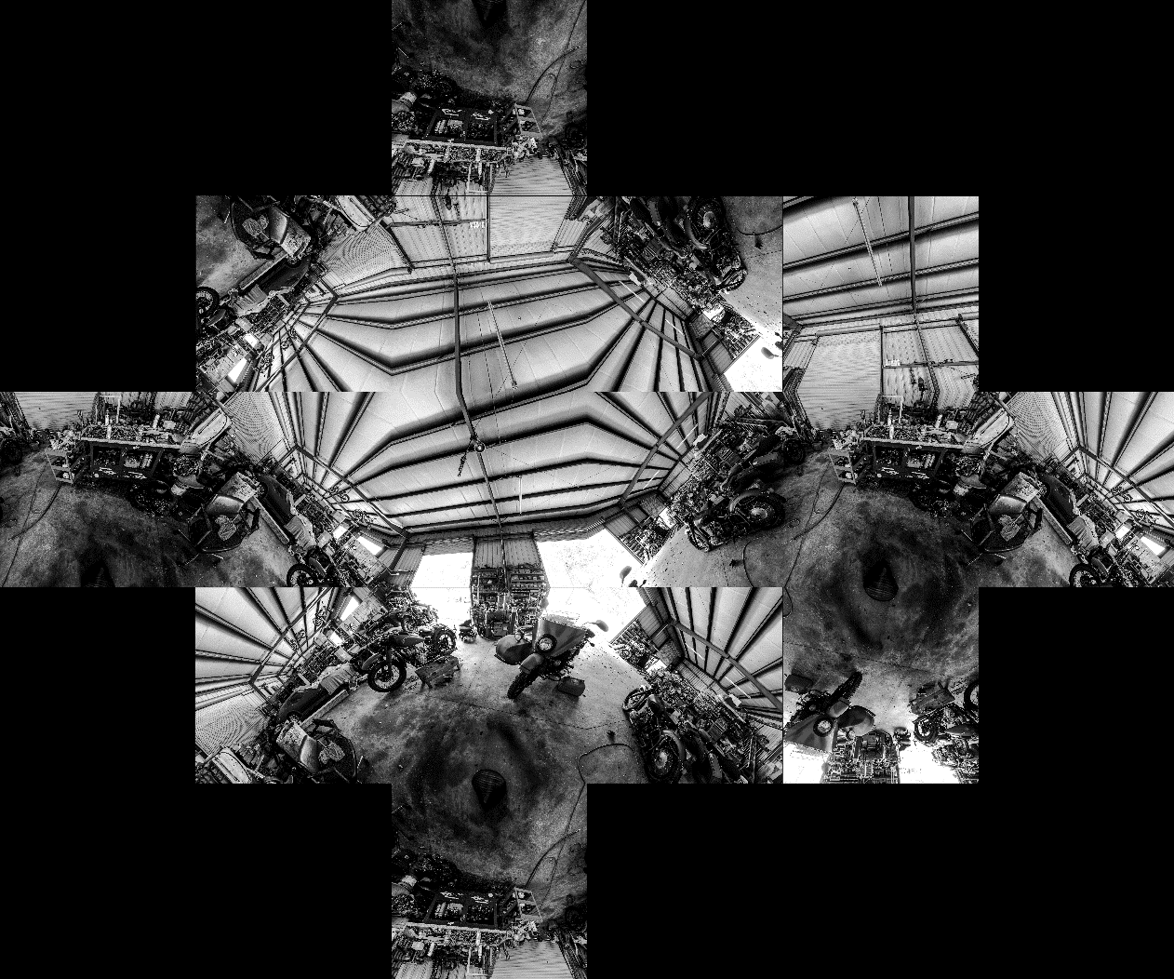
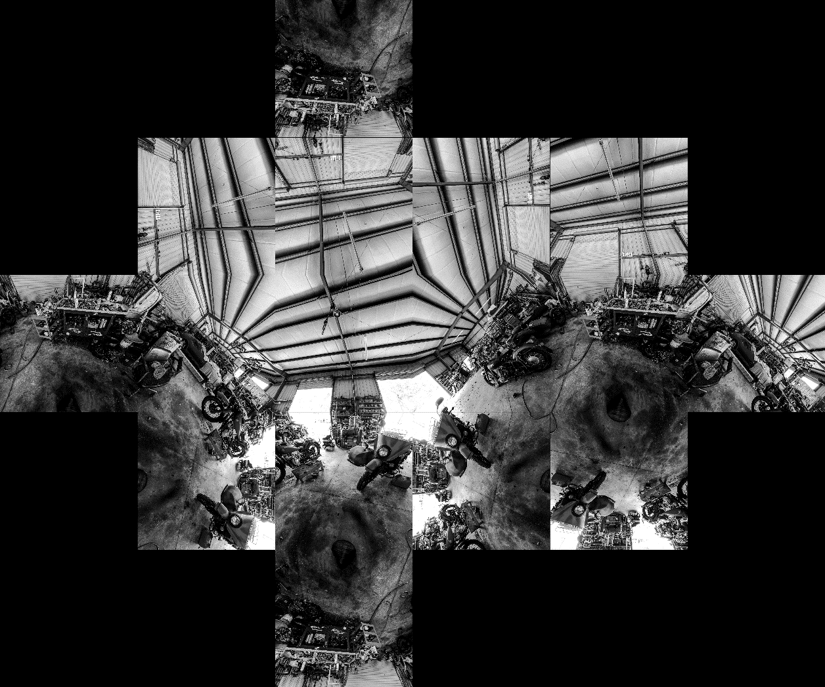
Extended Cutout: (0,45,0)

Slide 6
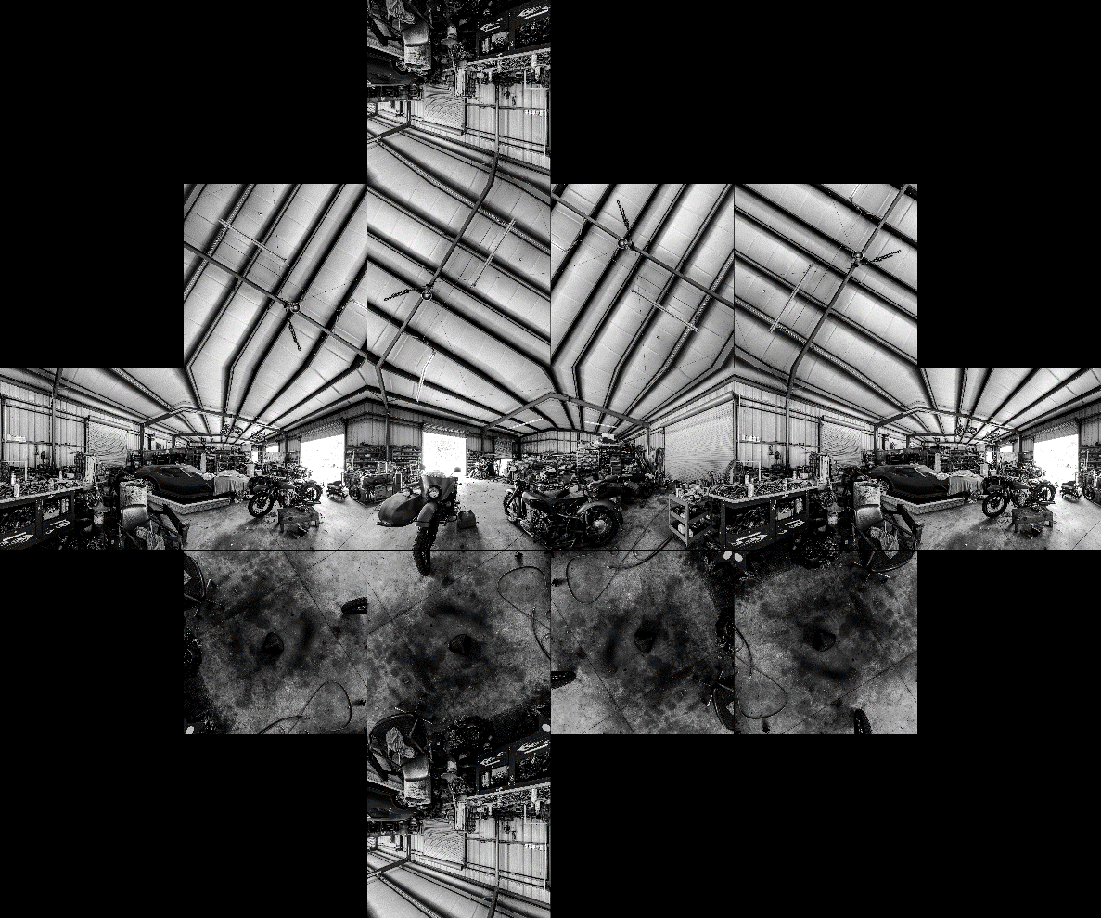
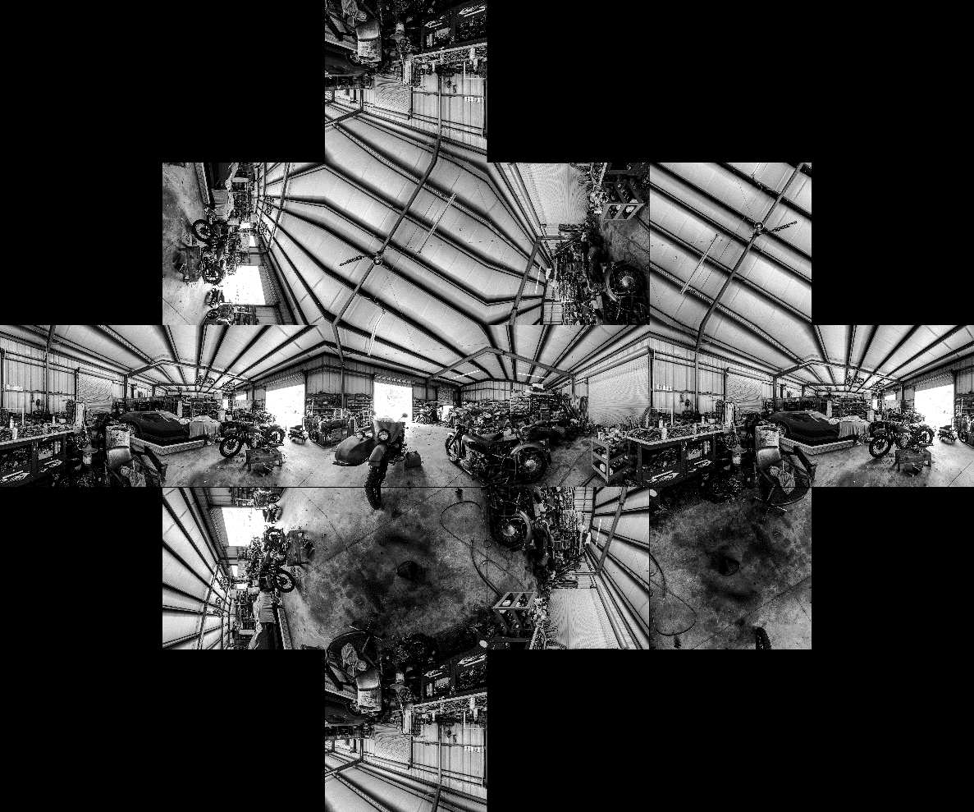
Extended Cutout (45,0,0)

Slide 7
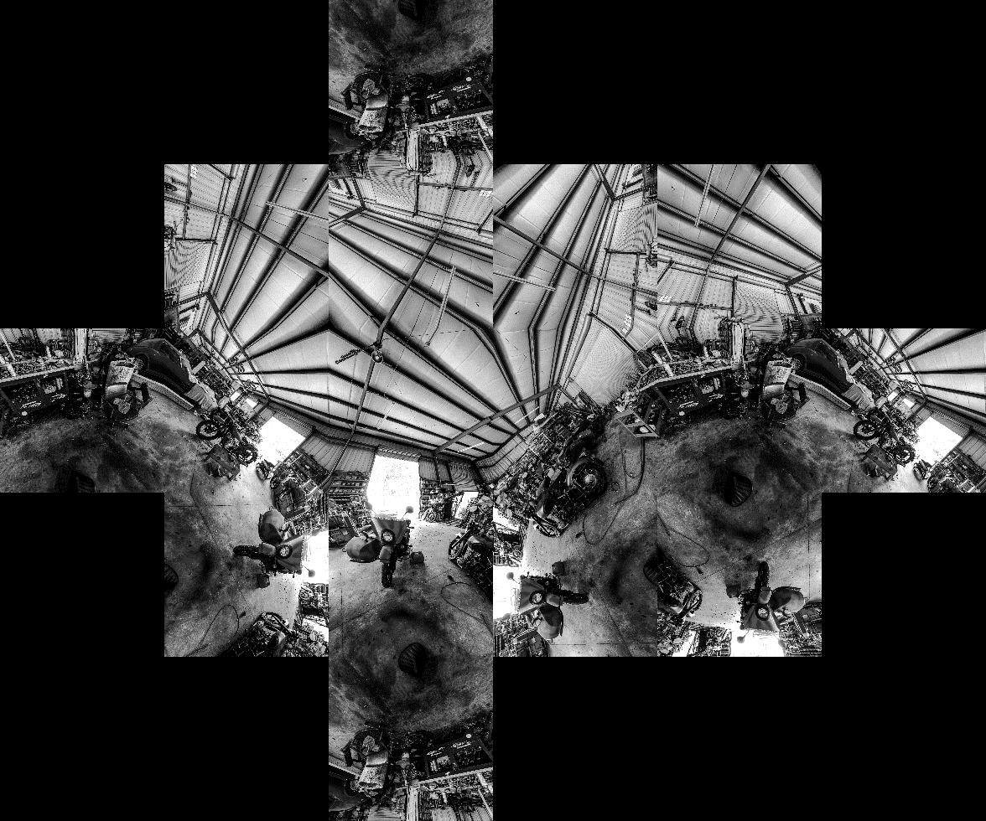
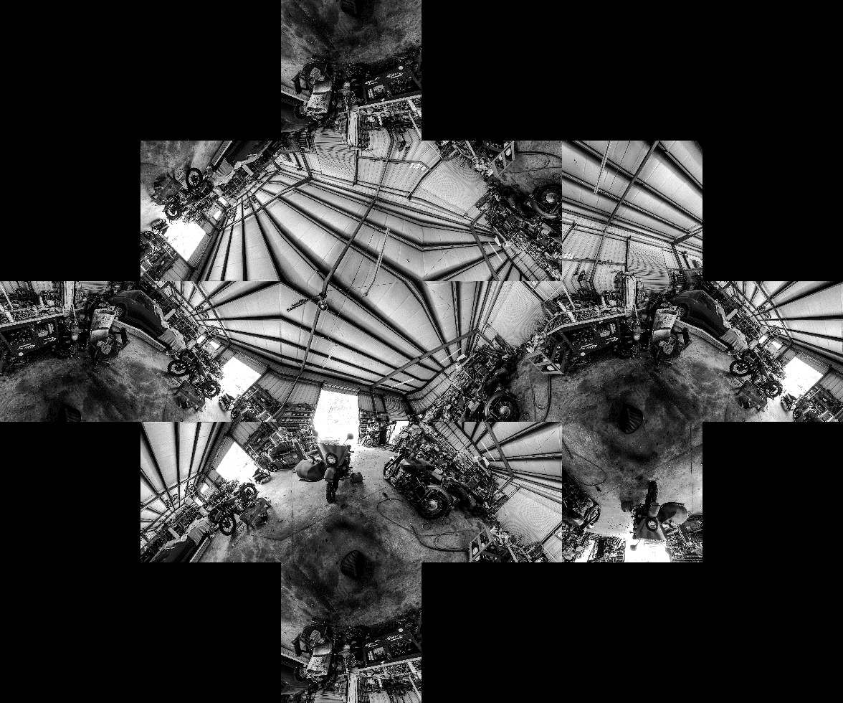
Extended Cutout (45,45,0)

Slide 8

2D predictor: BMS (average of 2 saliency maps)
(0,0,0):

Slide 9

(0,0,45)

Slide 10

(0,45,0)

Slide 11
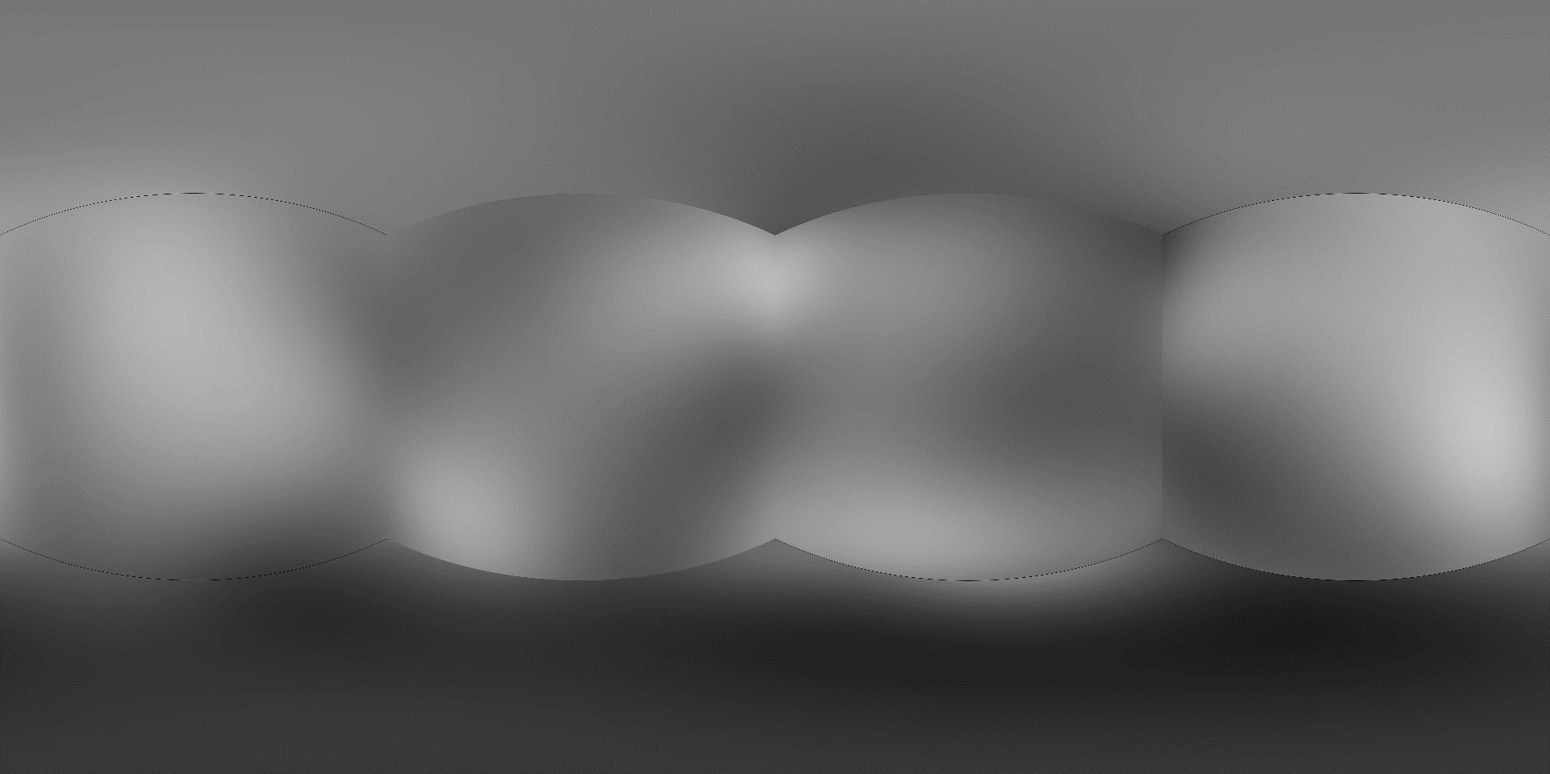
(45,0,0)

Slide 12

(45,45,0)

Slide 13

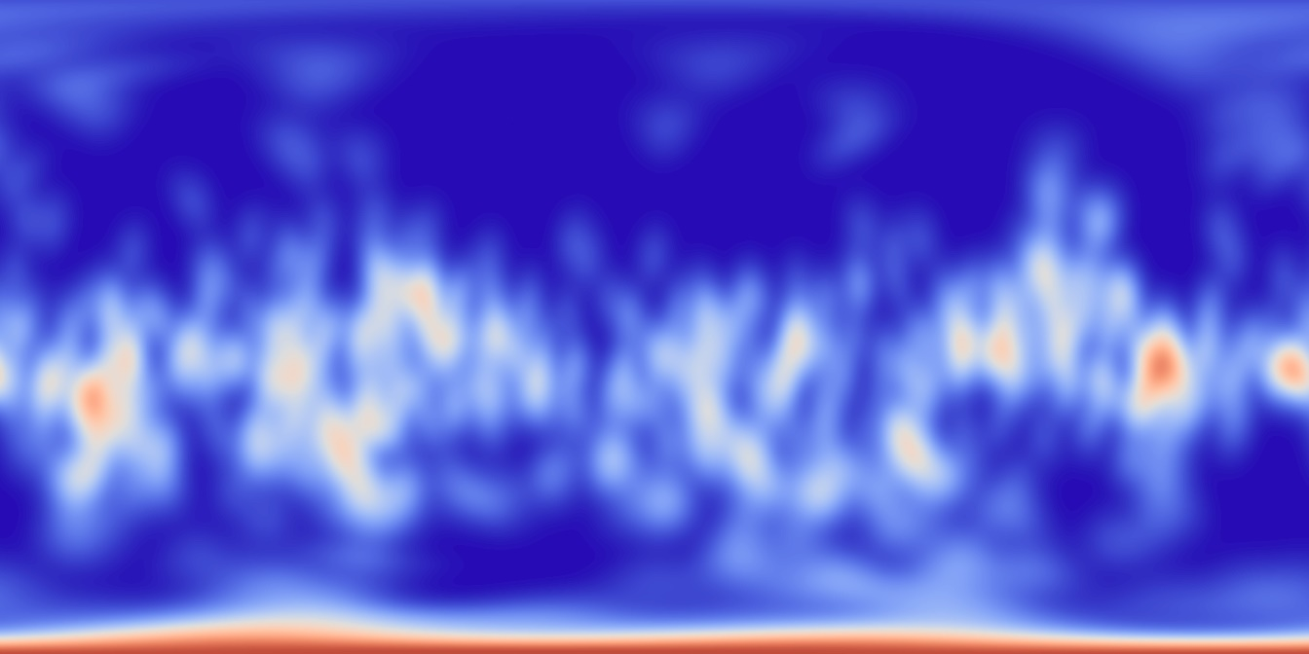
Final Map (Scaling and maximum)

Slide 14
Performance (without smoothening)
Correlation Coefficient: 0.2307
KL D: 0.8790
Saliency maps produced were inconsistent over various orientations
Poor performance of this saliency predictor! Hence tested using SalResnet saliency predictor.
Same procedure used as before

Slide 15
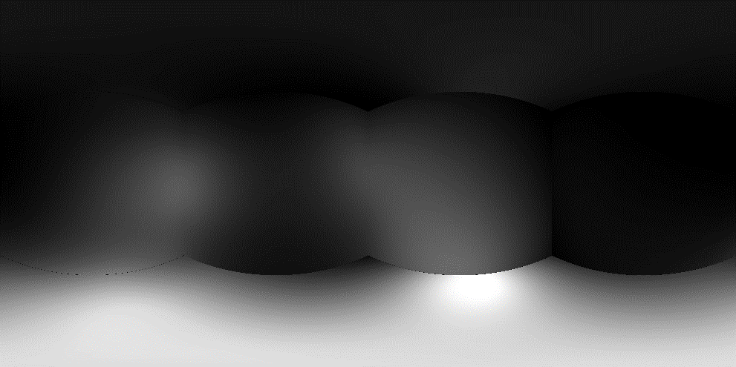
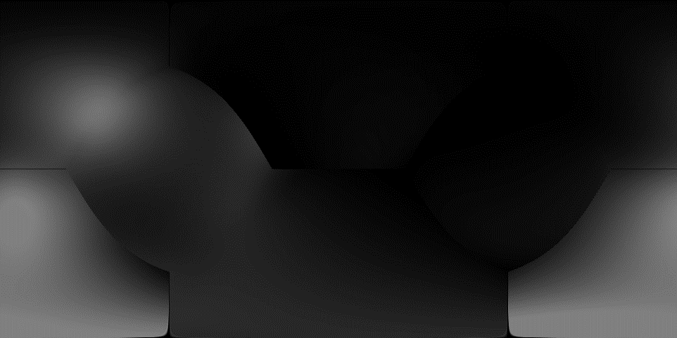

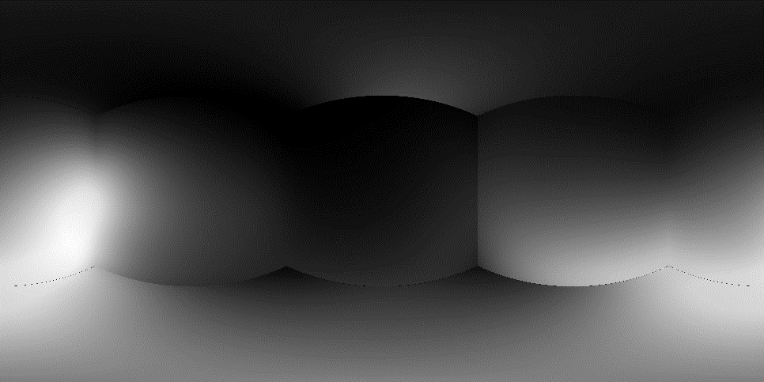
Maps using SalResNet

Slide 16


Final Map (without smoothening)

Slide 17
Performance:
Correlation Coefficient: 0.2705
KL D: 0.7202
Improvement over BMS however still performing poorly.
Graph cut based smoothening may help significantly improving the performance.

